Slide 1
JUNIOR ANALYST TRAINING SERIES
Fundamentals of Global Coal Markets
Understanding energy grades, Asia-Atlantic dynamics, benchmark pricing mechanics, and physical trade flow analytics.
Market Analysis
Seaborne Trade
API2 / API4 / Newcastle

Slide 2
COAL GRADES TAXONOMY
Spectrum of Coal: From Lignite to Metallurgical
Lowest Energy
Seaborne Standard
Industrial Standard
Lignite (Brown)
Thermal (Steam)
Metallurgical (Coking)
Energy: ~2,500–4,000 kcal/kg
Energy: 5,500–7,000 kcal/kg
Energy: High Grade / Low Ash
Un-traded locally burned fuel. Highly polluting (1.2 tCO2/MWh) & high sulfur (~3%).
Global power benchmark. Called "sea coal" in US. Primary focus of API & Newcastle pricing.
Essential for 74% of global steel production. Low moisture/sulfur coke feed stock.

Slide 3
GRADE ECONOMICS
Lignite: Cheap Energy vs Carbon Sensitivity
No International Trade Market
Uneconomic to transport long distances due to low energy density and high moisture.
EMISSIONS DISADVANTAGE
1.26x Higher Carbon Sensitivity
EU Cost Base Benchmark
Lignite Emission Factor
Median EU mining and fixed operating costs hover at 15 €/Ton.
1.20 tCO2 / MWh
Hard Coal Emission Factor
Strategic Self-Sufficiency
0.95 tCO2 / MWh
Cheapest baseload source providing domestic energy independence across Europe (e.g. Germany).

Slide 4
PRICE REFERENCES
The Three Pillar Seaborne Coal Indexes
API 2
API 4
NEWCASTLE
Northwest Europe (CIF ARA)
South Africa (FOB Richards Bay)
Australia (FOB Newcastle)
Import reference for Amsterdam, Rotterdam, Antwerp hub.
Primary export index bridging Atlantic and Indo-Pacific flows.
Asian demand benchmark. Key signal for Pacific Basin dynamics.
Spec: 6,000 kcal/kg
Largest African Terminal
Pacific Hub Driver

Slide 5
STRUCTURAL TRADE SHIFT
Market Gravity Shift: Atlantic Decline to Pacific Growth
European Union: Sunset Market
Asia: Global Demand Engine
• Strict decarbonization regulations and rising carbon prices (EUA).
• Primary growth engine for thermal and metallurgical coal.
• ARA terminal stock levels no longer drive global price discovery.
• China: Imports ~281M Tons/year; balances domestic support with seaborne buying.
• Post-2022 pivot away from historical Russian supply dependency (55% pre-war import reliance).
• India & Southeast Asia: Major destinations for US high-sulfur and Australian exports.

Slide 6
EXPORTERS & QUALITY
Key Global Exporters & Quality Constraints
Australia
United States
Colombia
South Africa
#1 global supplier of high-CV thermal & met coal. Dominant exporter alongside Qatar in LNG.
Requires $80/ton floor to maintain export flows. High sulfur content limits buyers (India key, Egypt emerging).
Premium low-sulfur thermal coal supplier, highly valued by strictly regulated power utilities.
Richards Bay (RBCT) serves as flexible swing exporter between European and Asian buyers.

Slide 7
CROSS-COMMODITY LINKAGE
Steel Demand as a Direct Driver of Met Coal
Positive Demand Transmission
74%
Rising steel demand / margins → Blast furnace utilization increases → Met coal spot prices surge.
Of total global steel production depends directly on metallurgical coal input for blast furnaces.
Negative Demand Transmission
Steel slowdown / construction slump → Steel mill margin compression → Fast met coal price correction.

Slide 8
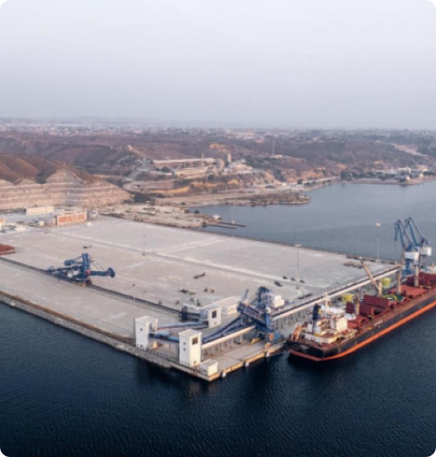
SUPPLY CHAIN RISK
Physical Bottlenecks & Route Vulnerabilities
Waterway Levels
Inland river levels (e.g., Rhine, Mississippi) restrict barge capacities, creating regional supply backlogs.
Weather & Storms
Cyclones in Queensland (Australia) or heavy rains in Kalimantan (Indonesia) rapidly halt mining and vessel loading.
Port Congestion Signaling
Tracking queue lengths and empty vessel counts anchored at Newcastle offers real-time physical demand signals.

Slide 9
DERIVATIVES & TRADING MECHANICS
API2 Futures Settlement Mechanics
Delivery Month Settlement Dynamics (e.g., March Contract)
Daily Calculation: Settles against the average daily API2 index values during the month of March.
Contract Spec
1 Lot = 1,000 MT
All API2 and API4 futures traded on ICE/CME settle financially in USD based on monthly average index values.
Active Trading: March contract remains active for trading throughout March while index prints daily.
Expiry & Final Strike: Last trading day is the last Friday of the month, but settlement strike calculates until calendar month-end.

